Slide 1
Introduction and Overview Traditional Algorithms vs ML
Understanding Machine Learning

Slide 2
Goals
understanding of foundational ML concepts and commonalities between different methods
ability to properly use ML for scientific or business problems

Slide 3
Schedule of Lectures and Exercises
lecture 1: introduction and overview
lecture 2: statistical learning
lecture 3: non-linear models
lecture 4: generalization
special edition: Blue Yonder
lecture 5: deep learning
lecture 6: transformers
lecture 7: generative models
lecture 8: causality
lecture 9: reinforcement learning
discussion of exercises: demand forecasting (issued in lectures 2, 4, 5, 7)

Slide 4
AI/ML Overview

Slide 5

Main Areas of Artificial Intelligence
computer vision
(spatial structures, state-of-the-art: Convolutional Neural Networks)
natural language processing
(sequential structures, state-of-the-art: transformers)
automated decision making, robotics
(reinforcement learning)
All of these are enabled by one key ingredient:
learning from experience (Machine Learning)
knowledge representation, automated reasoning
from wikipedia
from Artificial Intelligence: A Modern Approach (Russell, Norvig)

Slide 6
Buzz Words …
Artificial Intelligence
Deep Learning:
special kind of ML algorithms using (deep) neural networks
Data Science:
extract knowledge from data (by means of ML, among other things)
Machine Learning
Deep
Learning
Data Science

Slide 7

Traditional Algorithms and GOFAI
traditional algorithms:
explicit (handcrafted) instructions for each situation
symbolic AI (aka GOFAI):
use knowledge by means of symbols (as representations), logic, search (e.g., expert systems like Deep Blue)
Public perception is changing over time: A modern chess program, nowadays disparaged as brute computing, would have been considered intelligent in the 50s.
from wikipedia

Slide 8
ML: Learning from Experience/Data
mainly exploiting statistical dependencies with the aim of generalization to new (e.g., future) data
ML algorithm + data = explicit algorithm
reduction of complexity and much better generalizability compared to handcrafted algorithms
analogy: Humans do not hit the ground running, but have learning capabilities. → develop ML algorithm and let it learn from data

Slide 9

Hot Debate: Connectionism vs Symbolic AI
connectionists:
learn from (big) data without prior knowledge
symbolists:
use knowledge with only modest input data
(crude) analogy: learning and evolution
philosophical: empiricist and rationalist schools of mind
hybrid approaches often most successful:
e.g., AlphaGo with Deep Reinforcement Learning and Monte Carlo Tree Search
feature engineering for ML models also kind of symbolic knowledge representation
famous move 37
from Max Tegmark

Slide 10
Supercharging the Scientific Method
use ML and data to replace or enhance explicit methods relying on detailed domain knowledge (Software 2.0)
overcome our evolutionary limitations in math with clever learning algorithms and collecting data
immediate impact on many aspects of industry, business, science
rather than the (still philosophical) long-term quest for human-level AI (aka strong AI, AGI)

Slide 11
When to apply ML?
complexity
decisions under uncertainty, many influencing factors
e.g., demand forecasting, DNA sequencing
difficult for humans
automation
e.g., face and speech recognition, autonomous driving
goal to reach human-level performance
… and of course you need data to learn from

Slide 12
Learning Paradigms

Slide 13

Supervised Learning
learning by teacher → usually rather narrow tasks
Target Quantity
Features
known in training: labeled samples or observations from past
to be predicted for unknown cases (e.g., future values)
input information that is
correlated to target quantity
known at prediction time
Example: Spam Filtering
Classify emails as spam or no spam
use information like occurrence of specific words or email length as features
features x1 and x2 spam, no spam
use accordingly labeled emails as training set

Slide 14
Reinforcement Learning
learning by trial-and-error
goal-based approach → more generic than supervised learning (but sparse reward signals)
receiving feedback from the environment
no supervision
sequential decision making (delayed rewards)
exploration and exploitation

Slide 15


Unsupervised Learning
learning by observation
no target information → kind of “vague” pattern recognition (but plenty of data)
self-supervised:
input-output mapping like supervised learning
but generating labels itself from input information
learning of semantic feature representations
e.g., word2vec, BERT, GPT

Slide 16
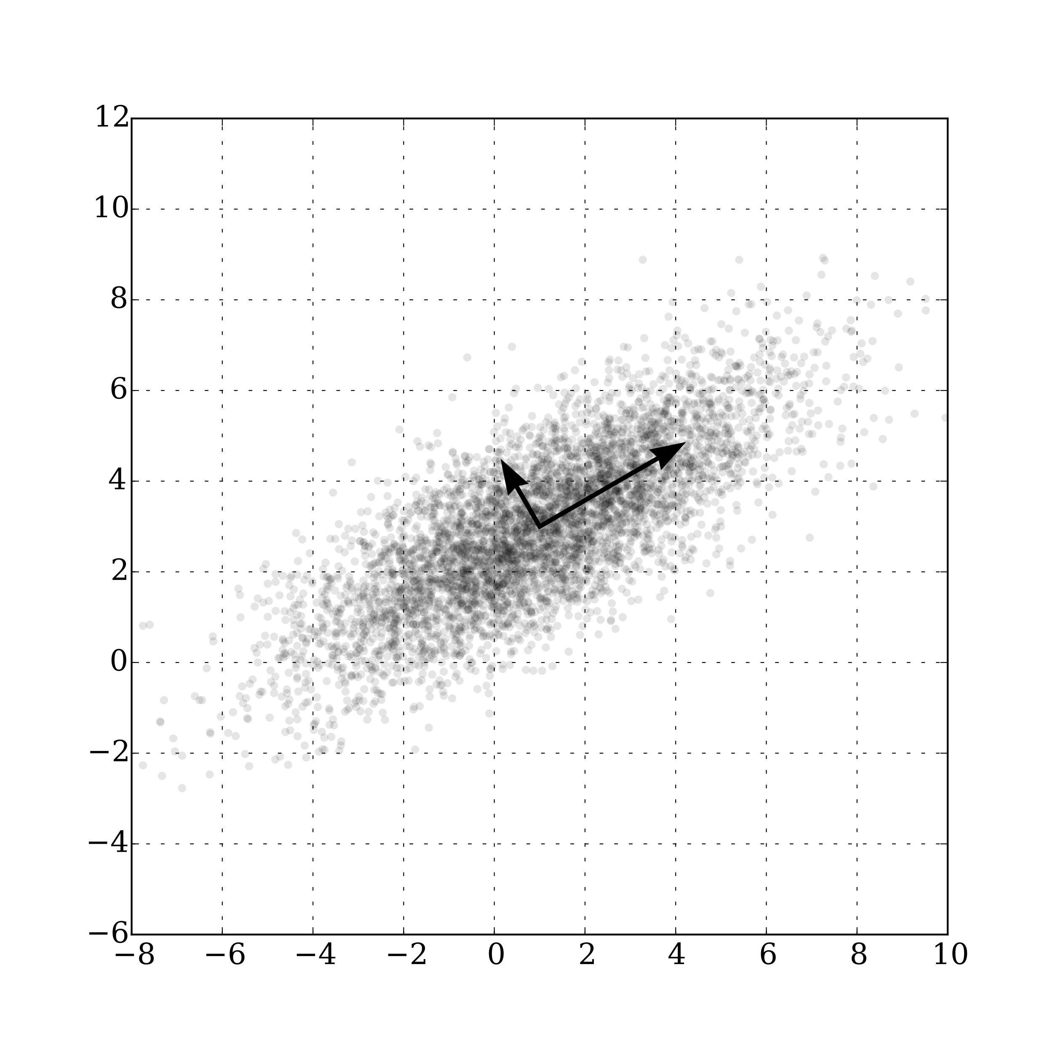
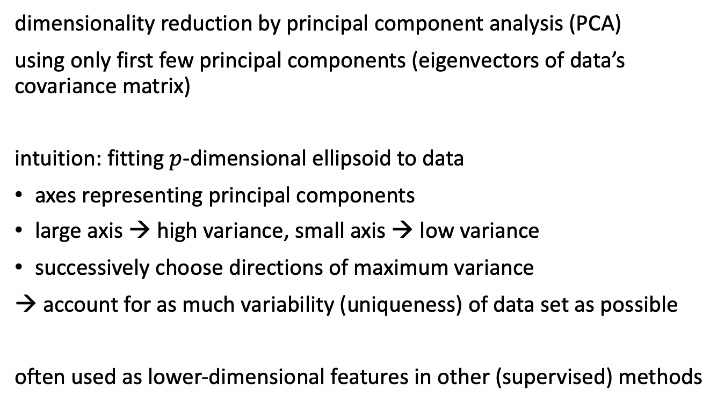
Example for Unsupervised Learning
dimensionality reduction by principal component analysis (PCA)
using only first few principal components (eigenvectors of data’s covariance matrix)
intuition: fitting $p$-dimensional ellipsoid to data
axes representing principal components
large axis → high variance, small axis → low variance
successively choose directions of maximum variance
→ account for as much variability (uniqueness) of data set as possible
often used as lower-dimensional features in other (supervised) methods
from wikipedia

Slide 17
Fitting / Statistical Learning

Slide 18

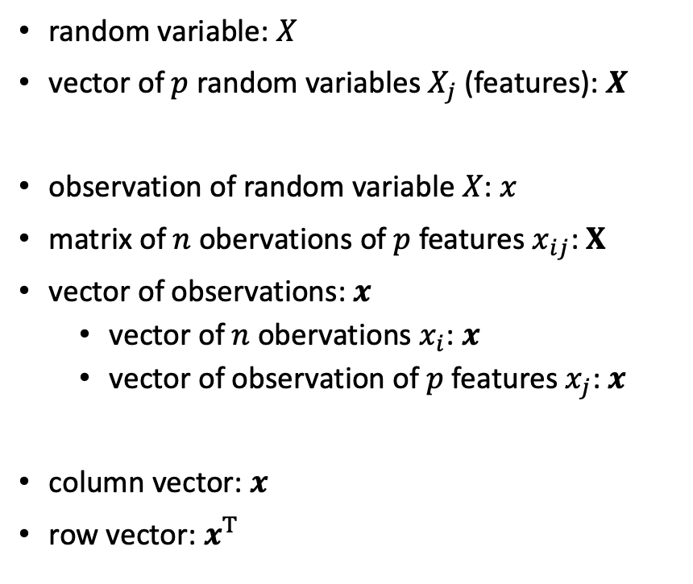
Notation
random variable: $X$
vector of $p$ random variables $X_{j}$ (features): $X$
observation of random variable $X$: $x$
matrix of $n$ obervations of $p$ features $x_{ij}$: $X$
vector of observations: $x$
vector of $n$ obervations $x_{i}$: $x$
vector of observation of $p$ features $x_{j}$: $x$
column vector: $x$
row vector: $x^{T}$
parameter: $β$
vector of parameters $β_{k}$: $β$
probability that $X$ takes on value $x_{0}$: $P\left(X=x_{0}\right)$
probability distribution: $p\left(x\right)=P\left(X=x\right)$
design matrix

Slide 19


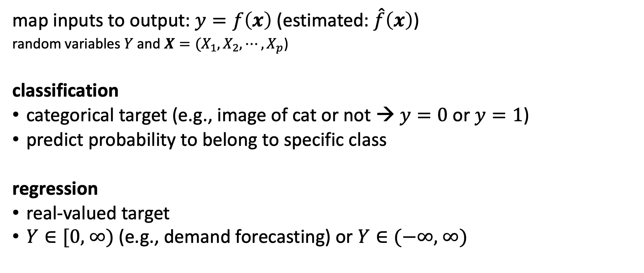
Supervised Learning Scenario
… ML …
map inputs to output: $y=f\left(x\right)$ (estimated: $\hat{f}\left(x\right)$)
random variables $Y$ and $X={(X}_{1}, X_{2},{⋯,X}_{p}$)
classification
categorical target (e.g., image of cat or not → $y=0$or $y=1$)
predict probability to belong to specific class
regression
real-valued target
$Y∈\text{[0, ∞)}$ (e.g., demand forecasting) or $Y∈\text{(−∞, ∞)}$
ML domain:
no deterministic dependencies between input and output

Slide 20

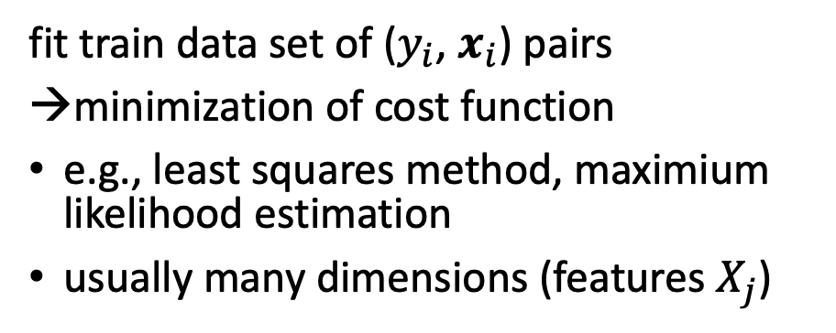
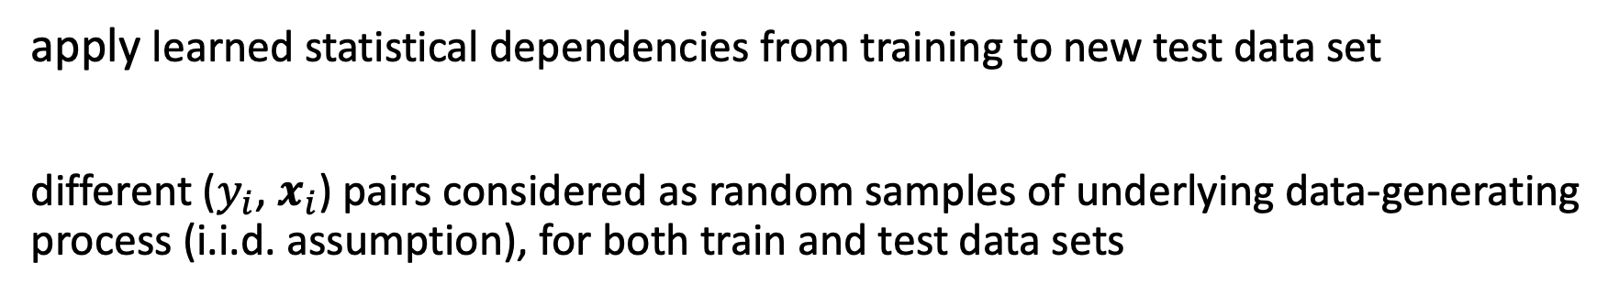
Curve Fitting / Parameter Estimation
d: degree of fitted polynomial → number of parameters
fit train data set of ($y_{i}$, $x_{i}$) pairs
minimization of cost function
e.g., least squares method, maximium likelihood estimation
usually many dimensions (features $X_{j}$)
from scikit-learn documentation
apply learned statistical dependencies from training to new test data set
different ($y_{i}$, $x_{i}$) pairs considered as random samples of underlying data-generating process (i.i.d. assumption), for both train and test data sets

Slide 21
Generalization
core of ML:
empirical risk minimization (training error) as proxy for minimizing unknown population risk (test error, aka generalization error or out-of-sample error)
generalization gap: difference between test and training error
interpolation: to unencountered samples from training environment
extrapolation: to testing conditions differing from training environment
curse of dimensionality: “learning in high dimensions always amounts to extrapolation” → need for appropriate inductive bias

Slide 22
Generalized Linear Models

Slide 23

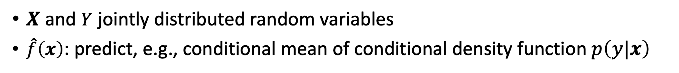
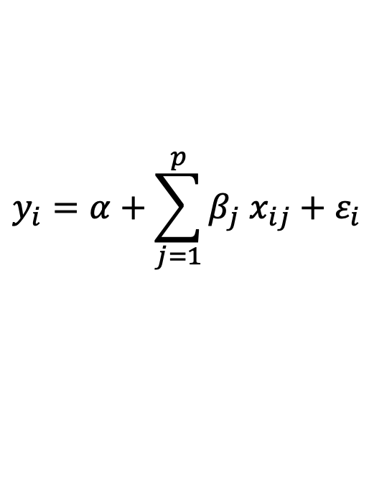
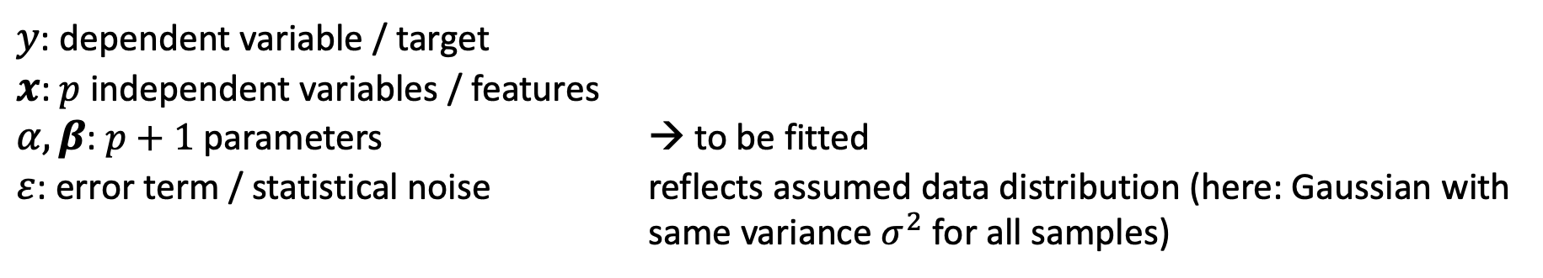
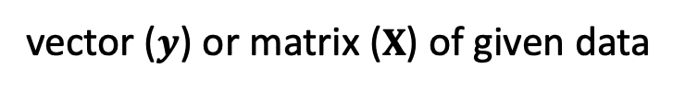
Linear Regression
$$y_{i}=α+\sum_{j=1}^{p}{β_{j} x_{ij}}+ε_{i}$$
(model)
}
from wikipedia
$y$: dependent variable / target
$x$: $p$ independent variables / features
$α,β$: $p+1$ parameters → to be fitted
$ε$: error term / statistical noise reflects assumed data distribution (here: Gaussian with same variance $σ^{2}$ for all samples)
vector ($y$) or matrix ($X$) of given data
$X$ and $Y$ jointly distributed random variables
$\hat{f}\left(x\right)$: predict, e.g., conditional mean of conditional density function $p\left(y|x\right)$
depending on used loss function
(conditional mean for squared loss of least squares method)

Slide 24
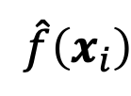
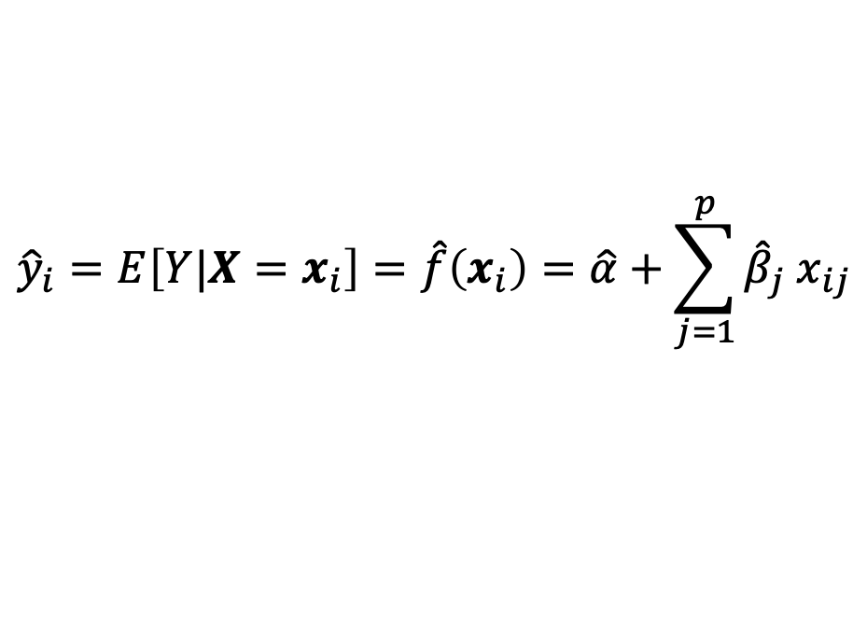

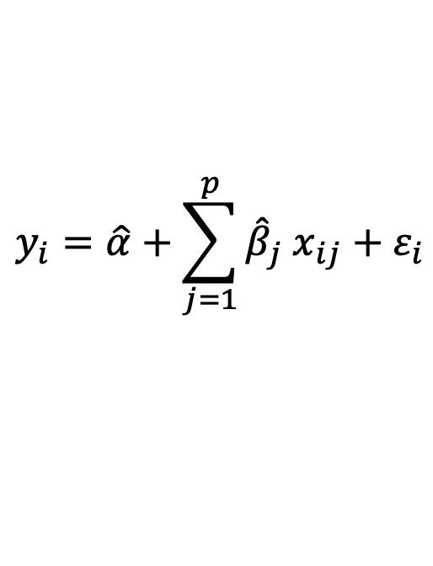
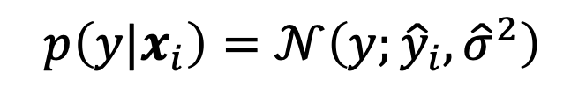
Linear Regression
$$\hat{f}\left(x_{i}\right)$$
fit:
to be estimated:
$\hat{α},\hat{β}$
${\hat{σ}}^{2}=$ $\frac{1}{n}\sum_{i=1}^{n}{{\left(y_{i}−\hat{f}\left(x_{i}\right)\right)}^{2}}$
(approximating assumed true $α, β$, $σ$)
$$y_{i}=\hat{α}+\sum_{j=1}^{p}{{\hat{β}}_{j} x_{ij}}+ε_{i}$$
Gaussian
predict:
$${\hat{y}}_{i}=E\left[Y|X=x_{i}\right]=\hat{f}\left(x_{i}\right)=\hat{α}+\sum_{j=1}^{p}{{\hat{β}}_{j} x_{ij}}$$
$$p\left(y|x_{i}\right)=𝒩\left(y;{\hat{y}}_{i}, {\hat{σ}}^{2}\right)$$
Gaussian
mean
variance

Slide 25

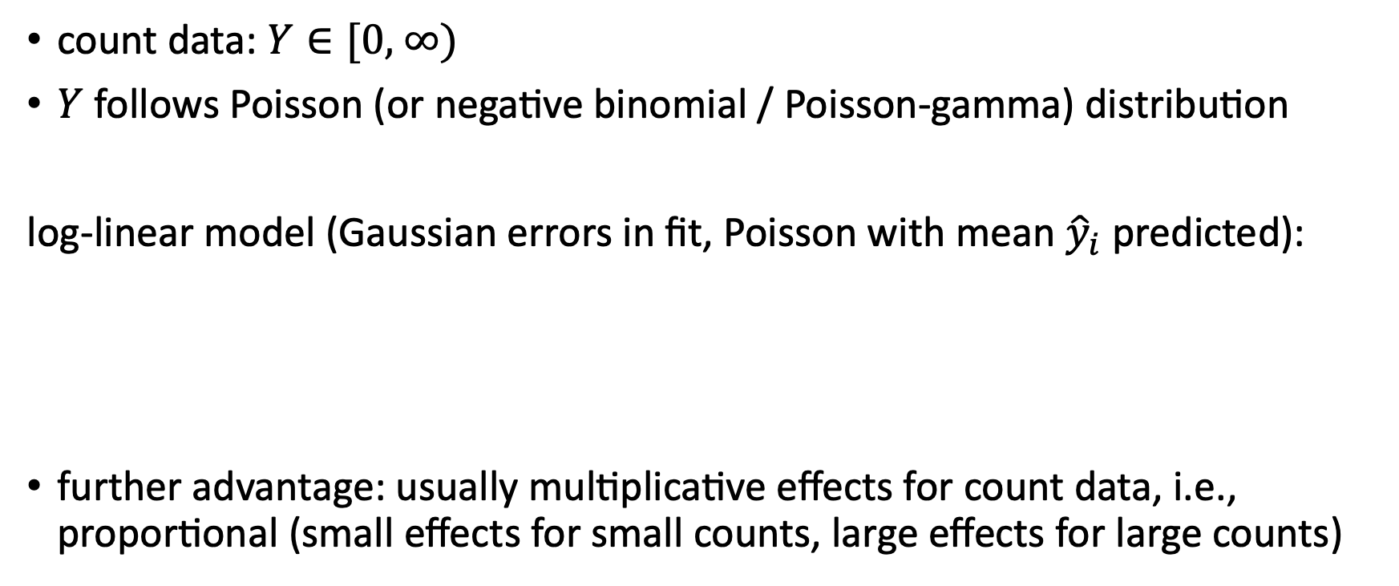
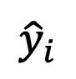
Multiplicative Model
count data: $Y∈\text{[0, ∞)}$
$Y$ follows Poisson (or negative binomial / Poisson-gamma) distribution
log-linear model (Gaussian errors in fit, Poisson with mean ${\hat{y}}_{i}$ predicted):
further advantage: usually multiplicative effects for count data, i.e., proportional (small effects for small counts, large effects for large counts)
$$\log\left(E\left[Y|X=x_{i}\right]\right)=\hat{α}+\sum_{j=1}^{p}{{\hat{β}}_{j} x_{ij}}$$
single parameter
$${\hat{y}}_{i}$$

Slide 26
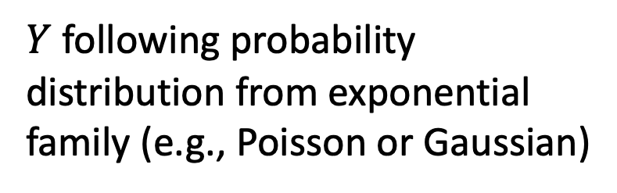
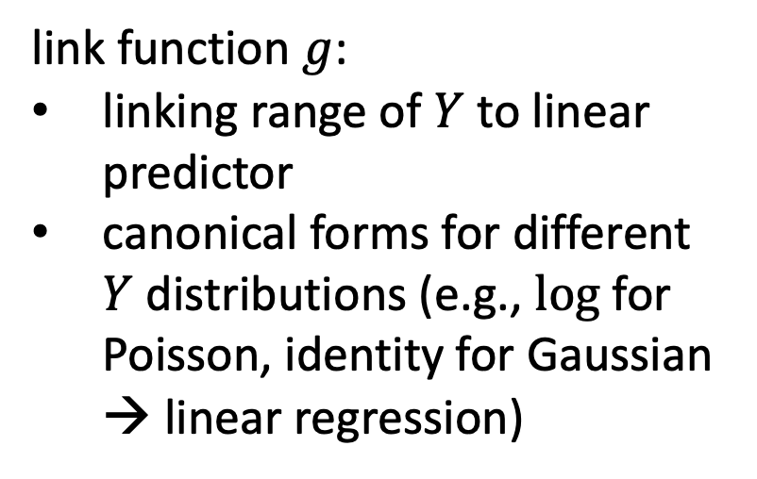
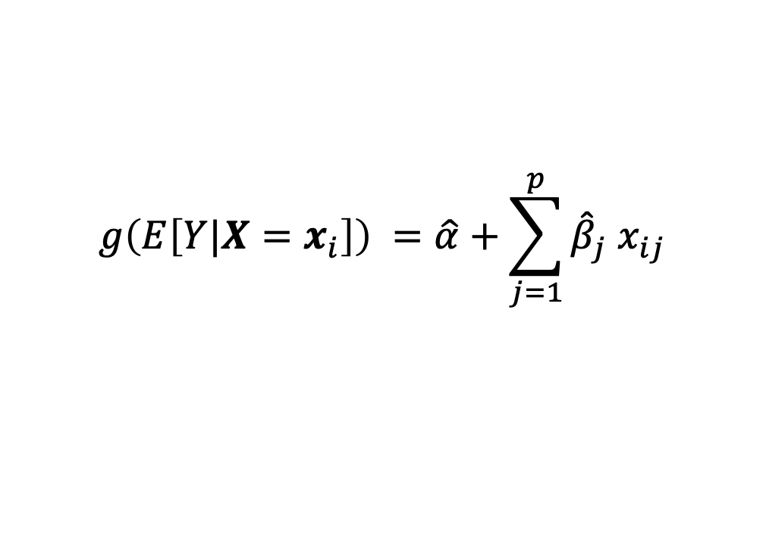
Scheme of Generalized Linear Models
$$g\left(E\left[Y|X=x_{i}\right]\right) =\hat{α}+\sum_{j=1}^{p}{{\hat{β}}_{j} x_{ij}}$$
link function $g$:
linking range of $Y$ to linear predictor
canonical forms for different $Y$ distributions (e.g., log for Poisson, identity for Gaussian → linear regression)
$Y$ following probability distribution from exponential family (e.g., Poisson or Gaussian)

Slide 27
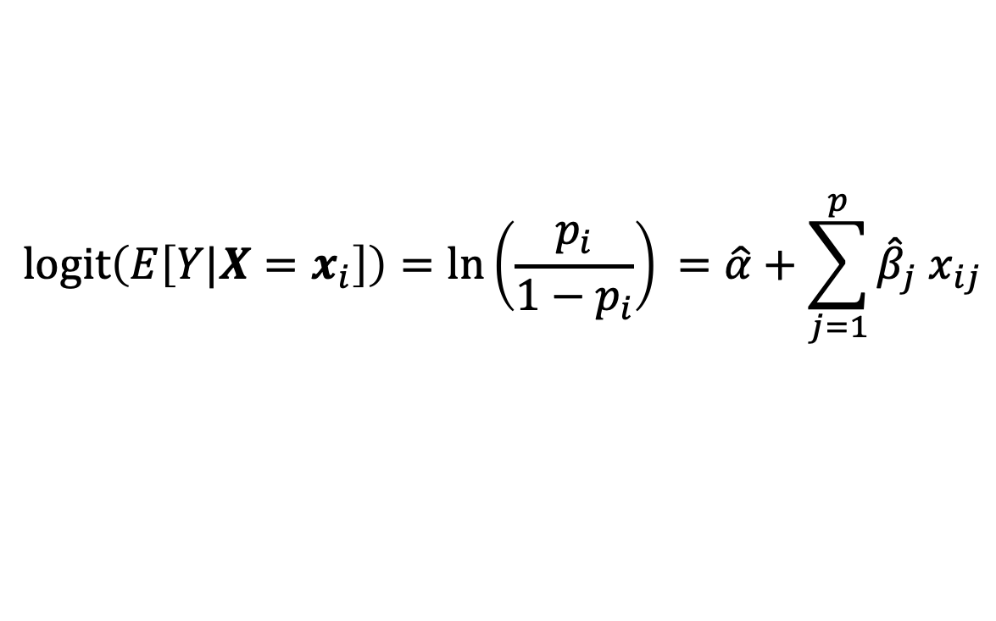

Classification: Logistic Regression
predict probability $p_{i}$ for $y=1$ respectively $y=0$ for each sample
link function: logit (log-odds)
$Y$ following Bernoulli distribution
$$\operatorname{logit}\left(E\left[Y|X=x_{i}\right]\right)=\ln\left(\frac{p_{i}}{1−p_{i}}\right)⁡=\hat{α}+\sum_{j=1}^{p}{{\hat{β}}_{j} x_{ij}}$$

Slide 28
Toward Non-Linear Models

Slide 29
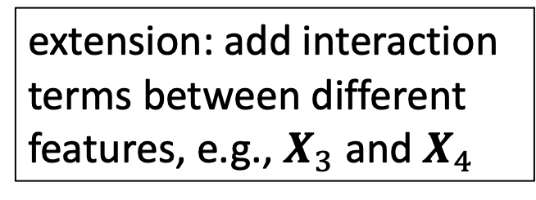
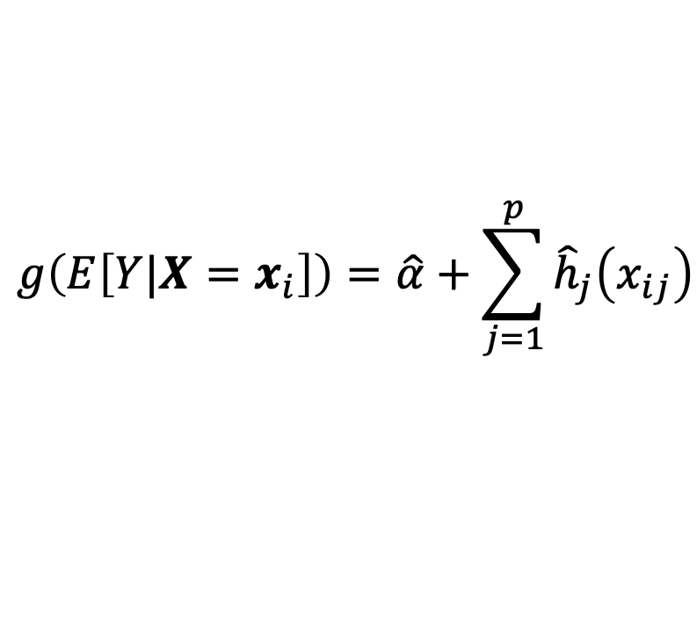
Generalized Additive Models
blending of Generalized Linear Models and additive models
$$g\left(E\left[Y|X=x_{i}\right]\right)=\hat{α}+\sum_{j=1}^{p}{{\hat{h}}_{j}\left(x_{ij}\right)}$$
extension: add interaction terms between different features, e.g., $X_{3}$ and $X_{4}$
smooth functions
potentially non-parametric form
describe non-linear effects
estimated, e.g., via backfitting algorithm
https://arxiv.org/abs/2002.03425

Slide 30

Algorithmic Families and Linear Building Blocks
linear (parametric) models
nearest neighbors (local methods, instance-based learning) – non-parametric models
decision trees
linear regression
Generalized Linear Models
Generalized Additive Models
Day
Weekday
Weekend
3
neural networks: non-linear just by means of activation functions
Promo
No
Yes
demand prediction
5
8
often used in ensemble methods
bagging: random forests
boosting: gradient boosting
kernel/support-vector machines: linear model (maximum-margin hyperplane) with kernel trick
from wikipedia

Slide 31
At its heart, all the diverse statistical learning methods are reflections of the same underlying concept, and just differ in their applicability for different use cases.
(need to find method with best inductive bias for the task at hand → generalization capability)

Slide 32
ML Workflow

Slide 33
Modeling
execute hyperparameter tuning
extract features
choose ML algorithm
help the ML algorithm to better understand the data
impose assumptions hard to discover in the raw data
from open-source libraries like scikit-learn or pytorch, rarely write an own one
many different algorithms available, differently suited for given task
variety of different forms
model settings not all automatically adjusted by the machine

Slide 34


Evaluation
test structure
measure accuracy of predictions
cross-validation
regression
point estimate: absolute (MAD, MSE, …) or relative (MAPE, …) metrics
full probability distribution: tricky ;)
classification
decide on acceptance of model changes by means of A/B tests: improved model vs baseline (current best)
ROC curve (true and false positve rates)
from wikipedia

Slide 35




MACHINE LEARNING
no supervision, but goal-based interaction with environment
training target available (labeled or past data)
data not labeled in any way
REINFORCEMENT LEARNING
SUPERVISED
UNSUPERVISED
CLASSIFICATION
ASSOCIATION
CLUSTERING
LEARN STATE OR ACTION VALUES
LEARN POLICY DIRECTLY
REGRESSION
DIMENSIONALITY REDUCTION
learning by teacher
(high-dimensional curve fitting)
learning by observation
(pattern recognition)
learning by trial-and-error
(sequential decision making)

Slide 36



Literature
nice book on the foundations of ML (relevant for the whole course):
other general overviews:
Bishop
Mitchell
Hastie

Slide 37



Scientific Application: ML in Particle Physics
https://arxiv.org/abs/1105.5995
https://arxiv.org/abs/1207.0825
example: classification of decay signatures in particle colliders
charmed baryon signals filtered out of background
Tevatron accelerator at Fermilab
CDF detector at Tevatron

